Slide 1
Chapter 11 Outlier Detection

Slide 2
Outline
Basic concepts
Statistical approaches
Proximity-based approaches
Reconstruction-based approaches
Clustering and classification based approaches
Mining contextual and collective outliers
Outlier detection in high-dimensional data

Slide 3
Motivation
How to detect suspicious credit card transactions, such as transactions of unusual amounts and multiple onsite transactions within 10 minutes in two locations hundreds of miles away?
Most transactions are normal and only very few are anormal
Outlier detection (also known as anomaly detection) is the process of finding outliers or anomalies, the data objects with behaviors that are very different from expectation
Many applications, such as medical care, public safety and security, industry damage detection, image processing, sensor and video network surveillance, national security, and system intrusion detection

Slide 4
Outlier Detection versus Clustering
Two highly related but different tasks
Difference in purpose
Clustering finds the majority patterns in a data set and organizes the data accordingly
Outlier detection tries to capture those exceptional cases that deviate substantially from the majority patterns
Difference in methodology
Outlier detection might also use supervision during the detection process
Clustering analysis is typically unsupervised in nature

Slide 5
Outline
Basic concepts
What are outliers?
Types of outliers
Challenges in outlier detection
Statistical approaches
Proximity-based approaches
Reconstruction-based approaches
Clustering and classification based approaches
Mining contextual and collective outliers
Outlier detection in high-dimensional data

Slide 6
What Are Outliers?
Assume that a given statistical process is used to generate a set of data objects
An outlier is a data object that deviates significantly from the rest of the objects, as if it were generated by a different mechanism
Outliers

Slide 7
Outliers versus Noise
Noise is a random error or variance in a measured variable, and thus is not interesting in data analysis, including outlier detection
Example: a bigger lunch one day or one more cup of coffee than usual
Outliers are interesting because they are suspected of not being generated by the same mechanism as the rest of the data
It is important to justify why the detected outliers are generated by some other mechanisms
Example: make various assumptions on the rest of the data and show that the detected outliers violate those assumptions significantly

Slide 8
Outlier Detection and Novelty detection
Example: monitoring a social media web site where new content is incoming, novelty detection may identify new topics and trends in a timely manner
Novel topics may initially appear as outliers
To this extent, outlier detection and novelty detection share some similarity in modeling and detection methods.
Difference: in novelty detection, once new topics are confirmed, they are usually incorporated into the model of normal behavior so that follow-up instances are not treated as outliers anymore

Slide 9
Three types of Outliers
Global outliers
Contextual (or conditional) outliers
Collective outliers

Slide 10
Global Outliers
A data object is a global outlier (or point anomaly) if it deviates significantly from the rest of the data set
Global outliers are the simplest type of outliers
Most outlier detection methods are aimed at finding global outliers
Global outliers

Slide 11
Detecting Global Outliers
It is critical to find an appropriate measurement of deviation with respect to the application in question
Global outlier detection is important in many applications
Example: intrusion detection in computer networks
Example: trading transaction auditing systems

Slide 12
Contextual Outliers
In a given data set, a data object is a contextual (or conditional) outlier if it deviates significantly with respect to a specific context of the object
Example: “It is 86 degrees today” – Is it exceptional and thus an outlier?
Yes, if today is in winter in Toronto, but no if today is in summer in Toronto
In contextual outlier detection, the context has to be specified as part of the problem definition

Slide 13
Contextual versus Behavioral Attributes
In contextual outlier detection, the attributes of the data objects in question are divided into two groups
The contextual attributes of a data object define the object’s context
In the temperature example, the contextual attributes may be date and location
The behavioral attributes define the object’s characteristics, and are used to evaluate whether the object is an outlier in the context to which it belongs
In the temperature example, the behavioral attributes may be the temperature, humidity, and pressure
Whether a data object is a contextual outlier depends on not only the behavioral attributes but also the contextual attributes

Slide 14
Contextual Outliers versus Global and Local Outliers
Contextual outliers are a generalization of local outliers
An object in a data set is a local outlier if its density significantly deviates from the local area in which it occurs
Global outlier detection can be regarded as a special case of contextual outlier detection where the set of contextual attributes is empty – global outlier detection uses the whole data set as the context
Contextual outlier analysis provides flexibility to users in that one can examine outliers in different contexts, which can be highly desirable in many applications
The quality of contextual outlier detection in an application depends on the meaningfulness of the contextual attributes, in addition to the measurement of the deviation of an object to the majority in the space of behavioral attributes

Slide 15
Collective Outliers
Given a data set, a subset of data objects forms a collective outlier if the objects as a whole deviate significantly from the entire data set, while importantly the individual data objects may not be outliers
Example: a student sick case in a class may not be considered outlying, but it is outlying if 10% of students are sick on a single day
Collective outliers

Slide 16
Applications of Collective Outliers
In intrusion detection, a denial-of-service package from one computer to another is considered normal, and not an outlier at all
However, if several computers keep sending denial-of-service packages to each other, they as a whole should be considered as a collective outlier
The computers involved may be suspected of being compromised by an attack
A stock transaction between two parties is considered normal
However, a large set of transactions of the same stock between two or a small number of parties in a short period are collective outliers because they may be evidence of some people manipulating the market
In collective outlier detection we have to consider not only the behavior of individual objects, but also that of groups of objects
To detect collective outliers, we need background knowledge of the relationship among data objects, such as distance or similarity measurements between objects

Slide 17
Comparison among Multiple Types of Outliers
A data set can have multiple types of outliers
An object may belong to more than one type of outlier
Different outliers may be used in various applications or for different purposes
Global outlier detection is the simplest
Context outlier detection requires background information to determine contextual attributes and contexts
Collective outlier detection requires background information to model the relationship among objects to find groups of outliers

Slide 18
Challenges of Outlier Detection
Modeling normal objects and outliers effectively
The border between data normality and abnormality (outliers) is often not clear-cut
Application-specific outlier detection
The relationship among objects highly depends on applications
Handling noise in outlier detection
Noise often unavoidably exists in data collected in many applications
Low data quality and the presence of noise bring a huge challenge to outlier detection
Interpretability: a user may want to not only detect outliers, but also understand why the detected objects are outliers

Slide 19
Outlier Detection Methods: An Overview
Supervised, Semi-Supervised, and Unsupervised Methods
Statistical methods, proximity-based methods, and reconstruction-based methods

Slide 20
Supervised, Semi-Supervised, and Unsupervised Methods
Supervised methods model data normality and abnormality
Imbalance data sets
Avoid many false positives in outlier detection
Unsupervised outlier detection methods make an implicit assumption: the normal objects are somewhat “clustered”
Semi-supervised methods: although obtaining some labeled examples is feasible, the number of such labeled examples is often small

Slide 21
Statistical Methods, Proximity-based Methods, and Reconstruction-based Methods
Statistical methods (also known as model-based methods) make assumptions of data normality
Example: detecting outliers using a statistical (Gaussian) model
Proximity-based methods assume that an object is an outlier if the nearest neighbors of the object are far away in feature space, that is, the proximity of the object to its neighbors significantly deviates from the proximity of most of the other objects to their neighbors in the same data set
Reconstruction-based methods: matrix-factorization based methods and pattern-based compression methods
The normal data samples often share certain similarities, they can often be represented in a more succinct way, compared with their original representation
With the succinct representation, we can well reconstruct the original representation of the normal samples
For samples which cannot be well reconstructed by such alternative, succinct representation, we flag them as outliers

Slide 22
Outline
Basic concepts
Statistical approaches
Parametric methods
Nonparametric methods
Proximity-based approaches
Reconstruction-based approaches
Clustering and classification based approaches
Mining contextual and collective outliers
Outlier detection in high-dimensional data

Slide 23
General Idea
The general idea behind statistical methods for outlier detection is to learn a generative model fitting the given data set, and then identify those objects in low-probability regions of the model as outliers
A parametric method assumes that the normal data objects are generated by a parametric distribution with a finite number of parameters Θ
The probability density function of the parametric distribution f (x, Θ) gives the probability that object x is generated by the distribution
The smaller this value, the more likely x is an outlier
A nonparametric method tries to determine the model from the input data

Slide 24
Detection of Univariate Outliers Based on Normal Distribution
Assumption: Data are generated from a normal distribution
Learn the parameters of the normal (i.e., Gaussian) distribution from the input data, and identify the points with low probability as outliers
Example: suppose a city’s average temperature values in July in the last 10 years are, in value-ascending order, 24.0◦C, 28.9◦C, 28.9◦C, 29.0◦C, 29.1◦C, 29.1◦C, 29.2◦C, 29.2◦C, 29.3◦C, and 29.4◦C
A normal distribution is determined by two parameters: the mean, μ, and the standard deviation, σ
Use the maximum likelihood method to estimate the parameters μ and σ
$$\ln{L\left(μ,σ^{2}\right)}=\sum_{i=1}^{n}{\ln{f(x_{i}|\left(μ,σ^{2}\right))}}=−\frac{n}{2}\ln\left(2π\right)−\frac{n}{2}\ln{σ^{2}}−\frac{1}{2σ^{2}}\sum_{i=1}^{n}{{\left(x_{i}−μ\right)}^{2}}$$
$$\hat{μ}=\overline{x}=\frac{1}{n}\sum_{i=1}^{n}{x_{i}}=28.61, {\hat{σ}}^{2}=\frac{1}{n}\sum_{i=1}^{n}{{\left(x_{i}−\overline{x}\right)}^{2}}=2.29$$
24.0◦C is an outlier, since $L\left(24 | \left(28.61, 2.29\right)\right)<0.15\%$

Slide 25
Boxplot Visualization
A five-number summary
The smallest nonoutlier value (Min)
The lower quartile (Q1)
The median (Q2)
The upper quartile (Q3), and
The largest nonoutlier value (Max)
The interquantile range (IQR) is defined as Q3 − Q1
Any object that is more than 1.5 × IQR smaller than Q1 or 1.5 × IQR larger than Q3 is treated as an outlier because the region between Q1 − 1.5 × IQR and Q3 + 1.5 × IQR contains 99.3% of the objects

Slide 26
Grubb’s Test
For each object x in a data set, the z-score is $z=\frac{|x−μ|}{σ}$
μ is the mean, and σ is the standard deviation of the input data
An object x is an outlier if $z≥\frac{n−1}{\sqrt{n}}\sqrt{\frac{t_{\frac{α}{2n},n−2}^{2}}{n−2+t_{\frac{α}{2n},n−2}^{2}}}$
$t_{\frac{α}{2n},n−2}^{2}$ is the value taken by a t-distribution at a significance level of $\frac{α}{2n}$

Slide 27
Detection of Multivariate Outliers
The central idea is to transform the multivariate outlier detection task into a univariate outlier detection problem
Multivariate outlier detection using the Mahalanobis distance
For a multivariate data set, let $\overline{o}$ be the sample mean vector
For an object, $o$, in the data set, the squared Mahalanobis distance from $o$ to $\overline{o}$ is $MDist\left(o, \overline{o}\right)={\left(o−\overline{o}\right)}^{T}S^{−1}(o−\overline{o})$, where $S$ is the sample covariance matrix
Apply Grubb’s test to $MDist\left(o, \overline{o}\right)$

Slide 28
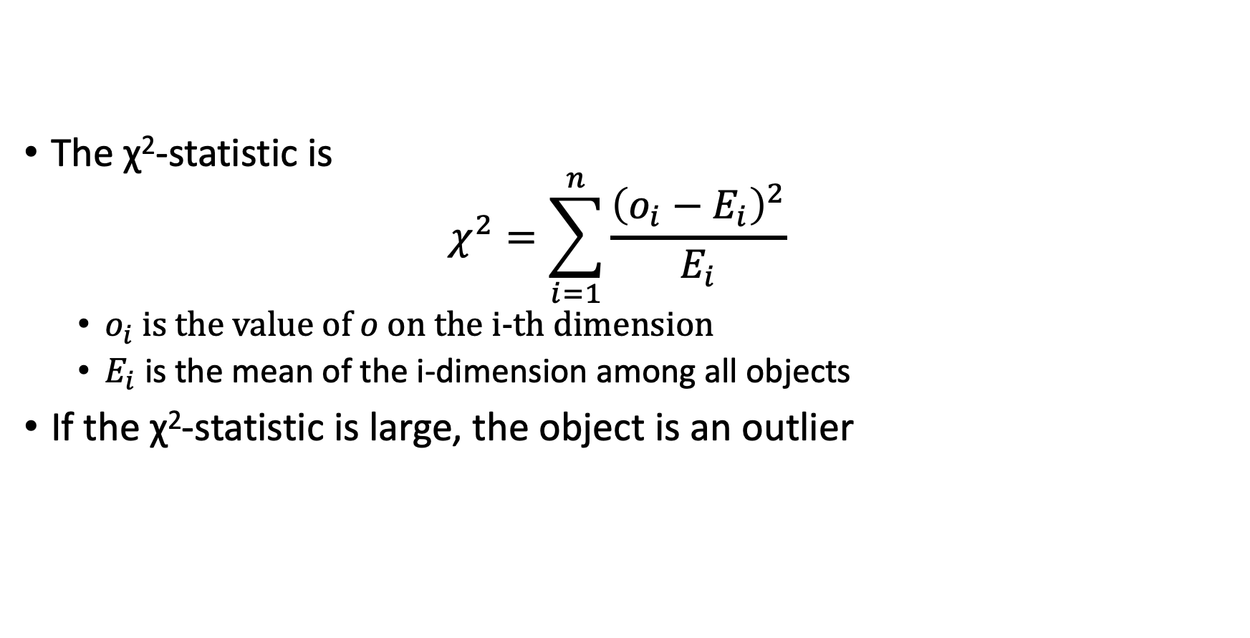
Multivariate Outlier Detection Using the χ²-statistic
The χ²-statistic is $χ^{2}=\sum_{i=1}^{n}{\frac{{\left(o_{i}−E_{i}\right)}^{2}}{E_{i}}}$
$o_{i}$is the value of $o$ on the i-th dimension
$E_{i}$ is the mean of the i-dimension among all objects
If the χ²-statistic is large, the object is an outlier

Slide 29
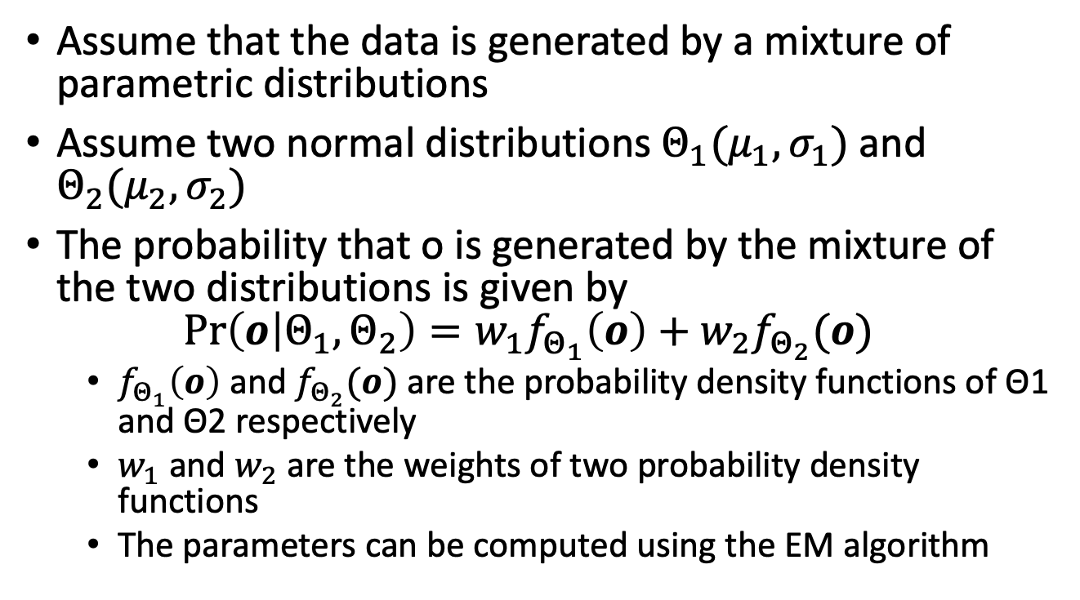
Using a Mixture of Parametric Distributions
Assume that the data is generated by a mixture of parametric distributions
Assume two normal distributions $Θ_{1}(μ_{1},σ_{1})$ and $Θ_{2}(μ_{2},σ_{2})$
The probability that o is generated by the mixture of the two distributions is given by $\operatorname{Pr}\left(o | Θ_{1},Θ_{2}\right)=w_{1}f_{Θ_{1}}\left(o\right)+w_{2}f_{Θ_{2}}(o)$
$f_{Θ_{1}}\left(o\right)$ and $f_{Θ_{2}}(o)$ are the probability density functions of Θ1 and Θ2 respectively
$w_{1}$ and $w_{2}$ are the weights of two probability density functions
The parameters can be computed using the EM algorithm

Slide 30
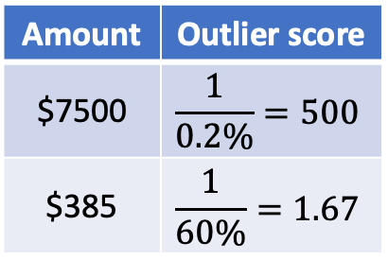
A Nonparametric Method: Using Histogram
Construct a histogram us- ing the input data (training data)
If the object falls in one of the histogram’s bins, the object is regarded as normal
Otherwise, it is considered an outlier
Use the histogram to assign an outlier score to an object, such as the reciprocal of the volume of the bin in which the object falls
Drawbacks: hard to choose an appropriate bin size
Amount | Outlier score
$7500 | $$\frac{1}{0.2\%}=500$$
$385 | $$\frac{1}{60\%}=1.67$$

Slide 31
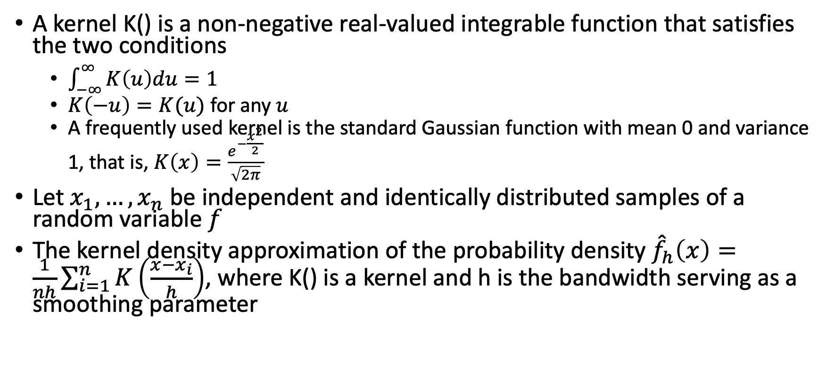
Kernel Density Estimation
A kernel K() is a non-negative real-valued integrable function that satisfies the two conditions
$\int_{−∞}^{∞}{K\left(u\right)du}=1$
$K\left(−u\right)=K(u)$ for any $u$
A frequently used kernel is the standard Gaussian function with mean 0 and variance 1, that is, $K\left(x\right)=\frac{e^{−\frac{x^{2}}{2}}}{\sqrt{2π}}$
Let $x_{1},…,x_{n}$ be independent and identically distributed samples of a random variable $f$
The kernel density approximation of the probability density ${\hat{f}}_{h}\left(x\right)=\frac{1}{nh}\sum_{i=1}^{n}{K\left(\frac{x−x_{i}}{h}\right)}$, where K() is a kernel and h is the bandwidth serving as a smoothing parameter

Slide 32
Pros and Cons of Statistical Methods
Advantage: the outlier detection may be statistically justifiable
Challenge: statistical methods for outlier detection on high-dimensional data
The computational cost of statistical methods depends on the models

Slide 33
Outline
Basic concepts
Statistical approaches
Proximity-based approaches
Distance-based outlier detection
Density-based outlier detection
Reconstruction-based approaches
Clustering and classification based approaches
Mining contextual and collective outliers
Outlier detection in high-dimensional data

Slide 34
Proximity-Based Approaches
Intuition: objects that are far from others can be regarded as outliers
Two types of proximity-based outlier detection methods
Distance-based methods: an object is then considered as an outlier if its neighborhood does not have enough other points
and density-based methods: an object is identified as an outlier if its density is relatively much lower than that of its neighbors

Slide 35
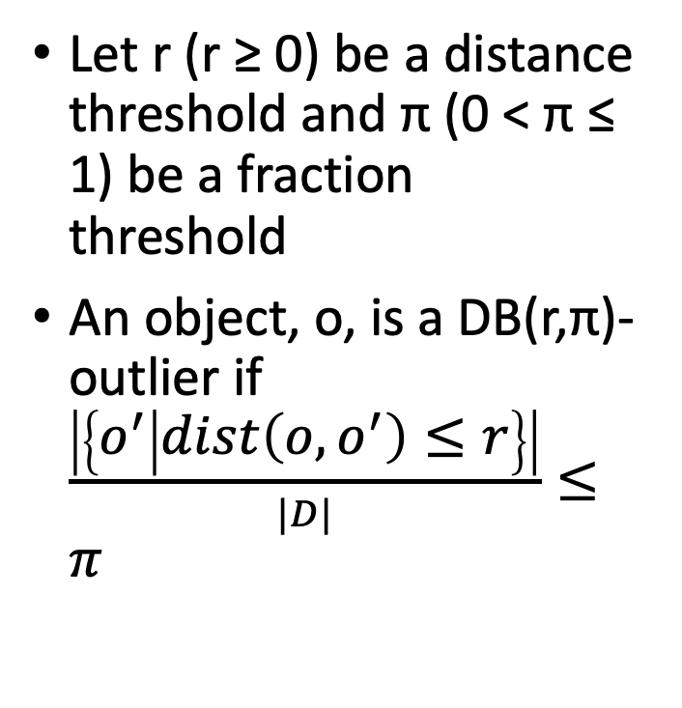
Distance-Based Outlier Detection
Let r (r ≥ 0) be a distance threshold and π (0 < π ≤ 1) be a fraction threshold
An object, o, is a DB(r,π)-outlier if $\frac{\left|\left\{o^{′} | dist\left(o, o^{′}\right)≤r\right\}\right|}{|D|}≤π$

Slide 36
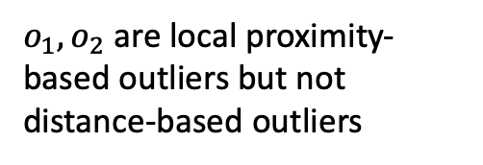
Density-Based Outlier Detection
Local proximity-based outliers
Challenge: how to measure the relative density of an object?
$o_{1},o_{2}$ are local proximity-based outliers but not distance-based outliers
Not a local outlier
A distance-based outlier

Slide 37
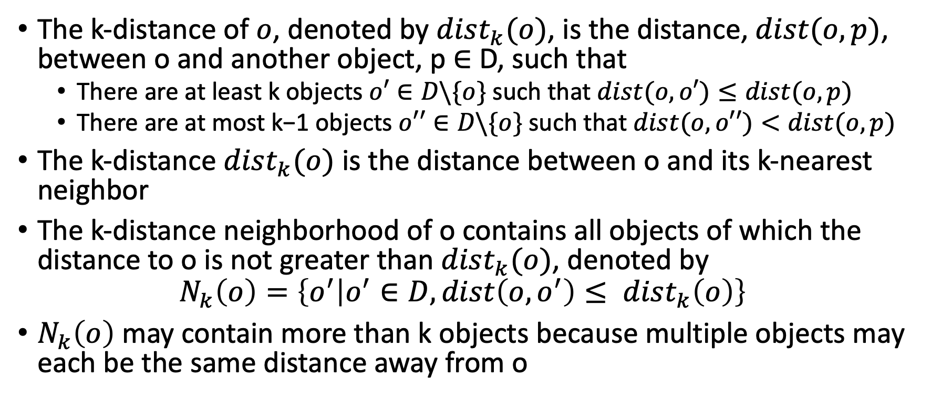
k-Distance
The k-distance of $o$, denoted by $dist_{k}(o)$, is the distance, $dist(o, p)$, between o and another object, p ∈ D, such that
There are at least k objects $o′∈D\backslash \{o\}$ such that $dist(o, o′)≤dist(o, p)$
There are at most k−1 objects $o′′∈D\backslash \{o\}$such that $dist(o, o′′)<dist(o, p)$
The k-distance $dist_{k}(o)$ is the distance between o and its k-nearest neighbor
The k-distance neighborhood of o contains all objects of which the distance to o is not greater than $dist_{k}(o)$, denoted by
$$N_{k}\left(o\right)=\left\{o^{′} | o^{′}∈D, dist\left(o, o^{′}\right)≤ dist_{k}\left(o\right)\right\}$$
$N_{k}\left(o\right)$ may contain more than k objects because multiple objects may each be the same distance away from o

Slide 38
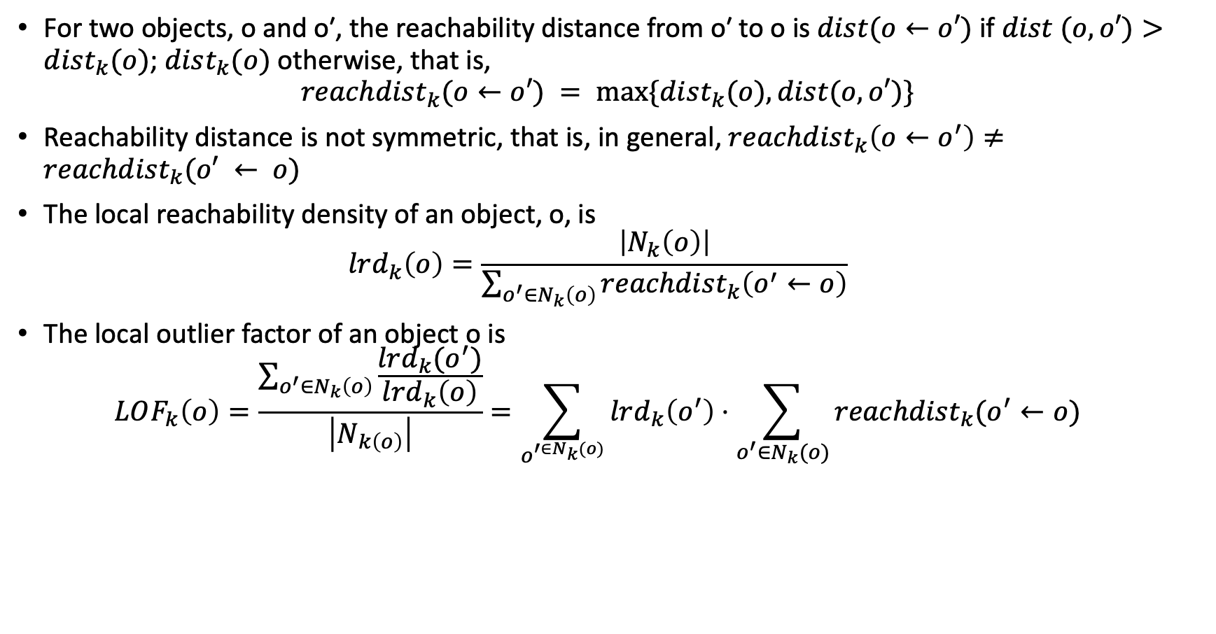
Reachability Distance and Local Outlier Factor
For two objects, o and o′, the reachability distance from o′ to o is $dist(o←o′)$ if $dist (o, o′)>dist_{k}(o)$; $dist_{k}(o)$ otherwise, that is,
$$reachdist_{k}(o←o′) = max⁡\{dist_{k}(o), dist(o, o′)\}$$
Reachability distance is not symmetric, that is, in general, $reachdist_{k}\left(o←o^{′}\right)≠reachdist_{k}(o′ ← o)$
The local reachability density of an object, o, is $lrd_{k}\left(o\right)=\frac{\left|N_{k}\left(o\right)\right|}{\sum_{o^{′}∈N_{k}\left(o\right)}{reachdist_{k}\left(o^{′}←o\right)}}$
The local outlier factor of an object o is $LOF_{k}\left(o\right)=\frac{\sum_{o^{′}∈N_{k}\left(o\right)}{\frac{lrd_{k}(o^{′})}{lrd_{k}\left(o\right)}}}{\left|N_{k\left(o\right)}\right|}=\sum_{o^{′∈N_{k}(o)}}{lrd_{k}\left(o^{′}\right)}⋅\sum_{o^{′}∈N_{k}(o)}{reachdist_{k}(o^{′}←o)}$

Slide 39
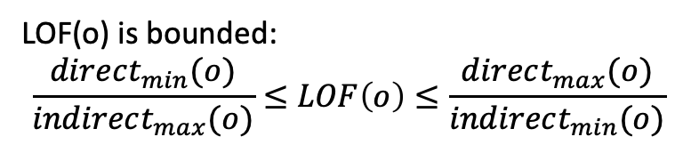
Nice Properties of the Local Outlier Factor
For an object deep within a consistent cluster, the local outlier factor is close to 1
For an object o, the meaning of LOF(o) is easy to understand
$$direct_{min}(o)=min⁡\{reachdist_{k}(o′←o)|o′∈N_{k}(o)\}$$
$$direct_{max}(o)=\max{\{reachdist_{k}(o′←o)|o′∈N_{k}(o)\}}⁡$$
$$indirect_{min}(o)=min⁡\{reachdist_{k}(o′′ ← o′)|o′∈N_{k}(o) and o′′∈N_{k}(o′)\}$$
$$indirect_{max}(o)=max⁡\{reachdist_{k}(o′′ ← o′)|o′∈N_{k}(o) and o′′∈N_{k}(o′)\}$$
LOF(o) is bounded: $$\frac{direct_{min}(o)}{indirect_{max}(o)}≤LOF\left(o\right)≤\frac{direct_{max}(o)}{indirect_{min}(o)}$$

Slide 40
Outline
Basic concepts
Statistical approaches
Proximity-based approaches
Reconstruction-based approaches
Matrix factorization based methods for numeric data
Pattern-based compression methods for categorical data
Clustering and classification based approaches
Mining contextual and collective outliers
Outlier detection in high-dimensional data

Slide 41
Reconstruction-Based Approaches: Example
Data mining: KDD and ICDM
Software engineering: FSE and ICSE

Slide 42
Key questions in Reconstruction-based Outlier Detection Methods
How to find the succinct representation
How to use the succinct representation to reconstruct the original data samples
How to measure the quality (i.e., goodness) of reconstruction

Slide 43
Matrix Factorization Based Methods for Numeric Data
Each data sample is represented as an attribute vector
The entire input data set is then represented as a data matrix
Rows are different data samples
Columns are different attributes
Entries of the data matrix indicate the attribute values of the corresponding data samples
Matrix factorization: approximate the data matrix by two or more low-rank matrices
The reconstruction error of each data sample is used as an indicator of the outlierness: the higher the reconstruction error, the more likely the given data sample is an outlier

Slide 44
Illustration

Slide 45
Algorithm

Slide 46
Singular Value Decomposition (SVD)
Given an input data matrix X, SVD approximates it by the multiplication of three rank-r matrices X ≈ UΣV′
U and V are orthonormal matrices, and their columns are called left singular vectors and right singular vectors of data matrix X, respectively
Σ is a diagonal with non-negative diagonal elements called singular values

Slide 47
Drawbacks of Matrix Factorization Based Method on Categorical Data
When a categorical attribute has many different values, the binary data matrix B would have many columns since we need to create a separate column (i.e., binary feature) for each categorical attribute value. This might make the matrix factorization process computationally intensive and the detection results hard to interpret

Slide 48
Creating a Code Table (Dictionary)
John and Amy can be represented by 01, ‘[I/H, C/H, P/H]’
Tom needs two code words, ‘[I/H, C/L]’ and ‘[P/M]’
Use the encoding length as an indicator of the outlierness: the longer the encoding length, the more likely the given data sample is an outlier

Slide 49
Outline
Basic concepts
Statistical approaches
Proximity-based approaches
Reconstruction-based approaches
Clustering and classification based approaches
Clustering-based approaches
Classification-based approaches
Mining contextual and collective outliers
Outlier detection in high-dimensional data

Slide 50
Three Clustering-based Outlier Detection Approaches
Does the object belong to any cluster? If not, then it is identified as an outlier
Is there a large distance between the object and the cluster to which it is closest? If yes, it is an outlier
Is the object part of a small or sparse cluster? If yes, then all the objects in that cluster are outliers

Slide 51
Classification-Based Approaches
The training set is typically heavily biased – the number of normal samples likely far exceeds the number of outlier samples
Classification-based outlier detection methods often use a one-class model
A classifier is built to describe only the normal class
Any samples that do not belong to the normal class are regarded as outliers

Slide 52
Outlier Detection by Semi-supervised Learning
Find clusters
If a large cluster contains mainly normal objects and unlabeled objects, treat those unlabeled objects as normal
Use a one-class model of this cluster to identify normal objects in outlier detection
If in a small cluster, there are some some outliers, and the others are unlabeled, label the other objects as outliers

Slide 53
Outline
Basic concepts
Statistical approaches
Proximity-based approaches
Reconstruction-based approaches
Clustering and classification based approaches
Mining contextual and collective outliers
Transforming Contextual Outlier Detection to Conventional Outlier
Modeling Normal Behavior with Respect to Contexts
Mining Collective Outliers
Outlier detection in high-dimensional data

Slide 54
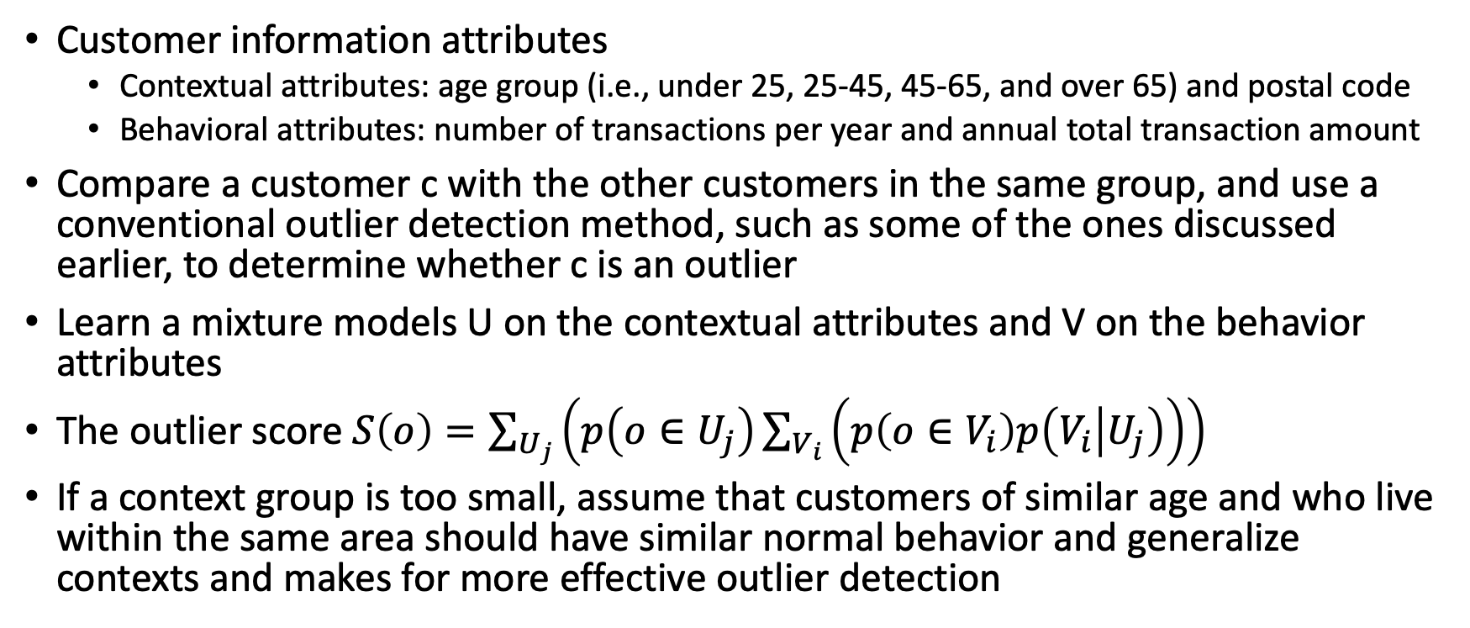
Identifying Context
Customer information attributes
Contextual attributes: age group (i.e., under 25, 25-45, 45-65, and over 65) and postal code
Behavioral attributes: number of transactions per year and annual total transaction amount
Compare a customer c with the other customers in the same group, and use a conventional outlier detection method, such as some of the ones discussed earlier, to determine whether c is an outlier
Learn a mixture models U on the contextual attributes and V on the behavior attributes
The outlier score $S\left(o\right)=\sum_{U_{j}}{\left(p\left(o∈U_{j}\right)\sum_{V_{i}}{\left(p\left(o∈V_{i}\right)p\left(V_{i} | U_{j}\right)\right)}\right)}$
If a context group is too small, assume that customers of similar age and who live within the same area should have similar normal behavior and generalize contexts and makes for more effective outlier detection

Slide 55
Modeling Normal Behavior with Respect to Contexts
In some applications, it is inconvenient or infeasible to clearly partition the data into contexts
Example: whether a customer purchases a product that is unrelated to the customer’s recent interest – it is hard to define the context precisely
Train a model that predicts the expected behavior attribute values with respect to the contextual attribute values
To determine whether a data object is a contextual outlier, apply the model to the contextual attributes of the object – If the behavior attribute values of the object significantly deviate from the values predicted by the model, then the object can be declared a contextual outlier
Example models: Markov models and finite state automaton

Slide 56
Collective Outliers
A group of data objects forms a collective outlier if the objects as a whole deviate significantly from the entire data set, even though each individual object in the group may not be an outlier
To detect collective outliers, we have to examine the structure of the data set, that is, the relationships between multiple data objects
For outlier detection in temporal data (e.g., time series and sequences), explore the structures formed by time, which occur in segments of the time series or subsequences
To detect collective outliers in spatial data, explore local areas
In graph and network data, explore subgraphs
The critical difference in collective outlier detection is that the structures are often not explicitly defined, and need to be discovered as part of the outlier detection process

Slide 57
Collective Outlier Detection on Graph Data
Input: a social network as an unlabeled graph
Treat each possible subgraph of the network as a structure unit
For each subgraph S, extract two features
|S|: the number of vertices in S
freq(S): the number of different subgraphs in the network that are isomorphic to S
Outlier subgraphs
Small subgraphs that are of very low frequency
Large subgraphs that are surprisingly frequent

Slide 58
Outline
Basic concepts
Statistical approaches
Proximity-based approaches
Reconstruction-based approaches
Clustering and classification based approaches
Mining contextual and collective outliers
Outlier detection in high-dimensional data
Extending Conventional Outlier Detection
Finding Outliers in Subspaces
Outlier Detection Ensemble
Taming High-Dimensionality by Deep Learning
Modeling High-Dimensional Outliers

Slide 59
Challenges: Outlier Detection in High-Dimensional Data
Interpretation of outliers
Data sparsity
The distance between objects becomes heavily dominated by noise as the dimensionality increases
Adaptive to data subspaces
Scalability with respect to dimensionality

Slide 60
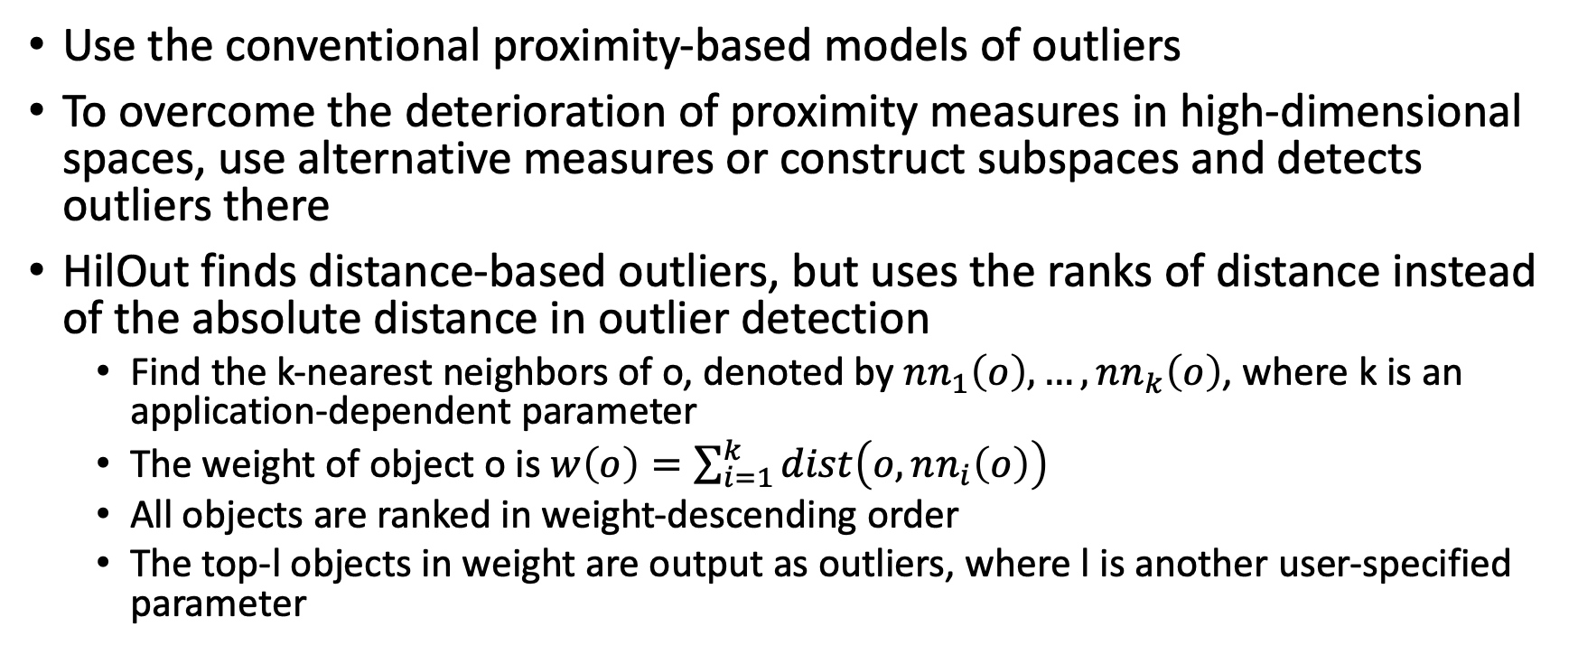
Extending Conventional Outlier Detection
Use the conventional proximity-based models of outliers
To overcome the deterioration of proximity measures in high-dimensional spaces, use alternative measures or construct subspaces and detects outliers there
HilOut finds distance-based outliers, but uses the ranks of distance instead of the absolute distance in outlier detection
Find the k-nearest neighbors of o, denoted by $nn_{1}\left(o\right), …, nn_{k}\left(o\right)$, where k is an application-dependent parameter
The weight of object o is $w\left(o\right)=\sum_{i=1}^{k}{dist\left(o,nn_{i}\left(o\right)\right)}$
All objects are ranked in weight-descending order
The top-l objects in weight are output as outliers, where l is another user-specified parameter

Slide 61
Finding Outliers in Subspaces
Search for outliers in various subspaces
If an object is found to be an outlier in a subspace of much lower dimensionality, the subspace provides critical information for interpreting why and to what extent the object is an outlier
Example: Alice, is an outlier in a lower-dimensional subspace that contains the dimensions average transaction amount and purchase frequency, such that her average transaction amount is substantially larger than the majority of the customers, and her purchase frequency is dramatically lower

Slide 62
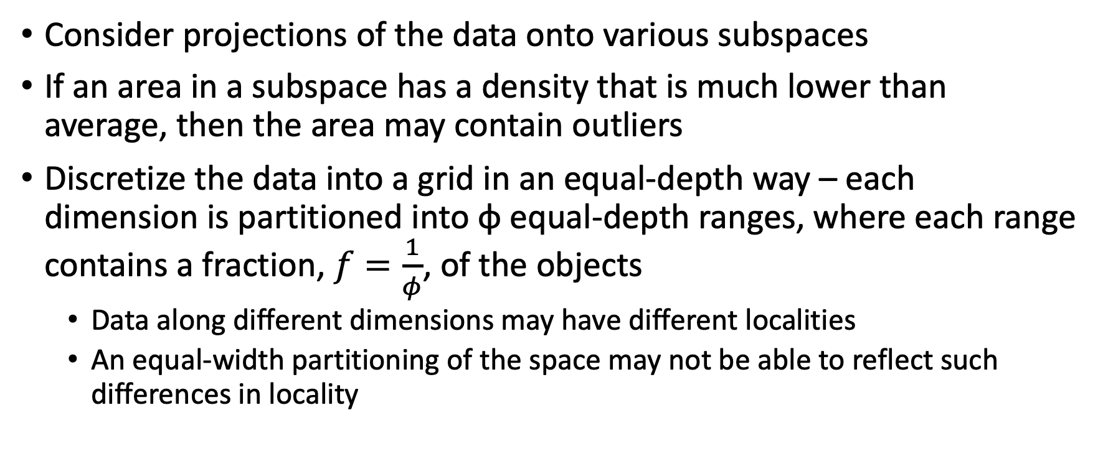
A Grid-Based Subspace Outlier Detection Method
Consider projections of the data onto various subspaces
If an area in a subspace has a density that is much lower than average, then the area may contain outliers
Discretize the data into a grid in an equal-depth way – each dimension is partitioned into φ equal-depth ranges, where each range contains a fraction, $f=\frac{1}{φ}$, of the objects
Data along different dimensions may have different localities
An equal-width partitioning of the space may not be able to reflect such differences in locality

Slide 63
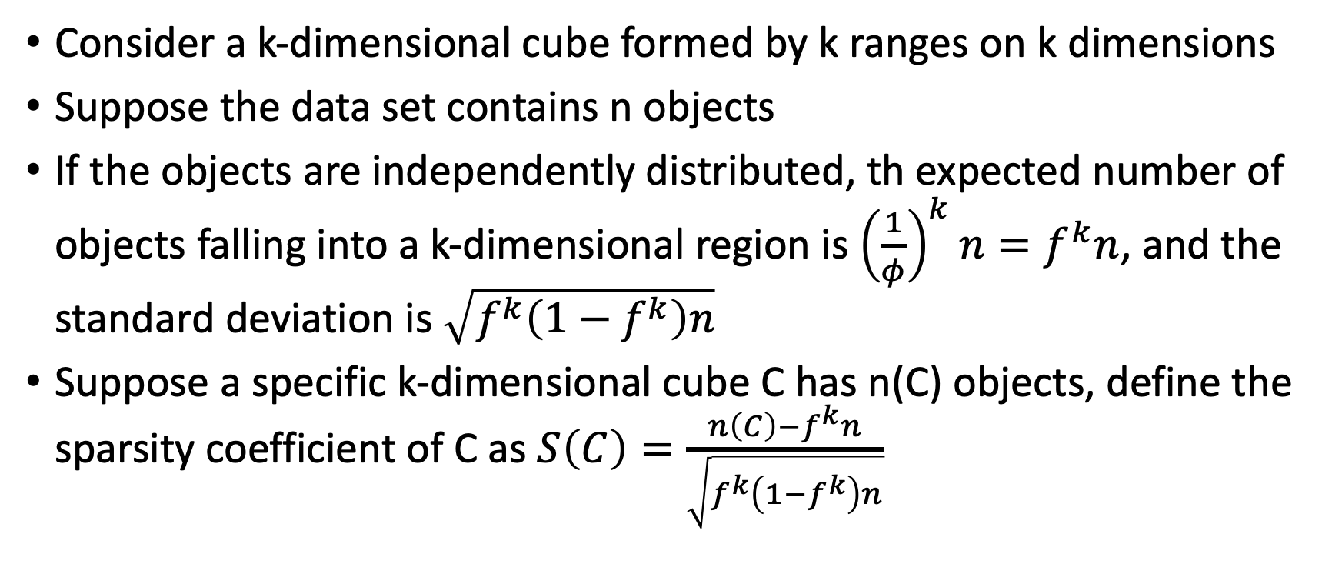
Measuring Sparsity of Regions in Subspaces
Consider a k-dimensional cube formed by k ranges on k dimensions
Suppose the data set contains n objects
If the objects are independently distributed, th expected number of objects falling into a k-dimensional region is ${\left(\frac{1}{φ}\right)}^{k}n=f^{k}n$, and the standard deviation is $\sqrt{f^{k}\left(1−f^{k}\right)n}$
Suppose a specific k-dimensional cube C has n(C) objects, define the sparsity coefficient of C as $S\left(C\right)=\frac{n\left(C\right)−f^{k}n}{\sqrt{f^{k}\left(1−f^{k}\right)n}}$

Slide 64
Detecting Outliers
If S(C) < 0, then C contains fewer objects than expected
The smaller the value of S(C), the sparser C is and the more likely the objects in C are outliers in the subspace
By assuming S(C) follows a normal distribution, we can determine the significance level for an object being an outlier

Slide 65
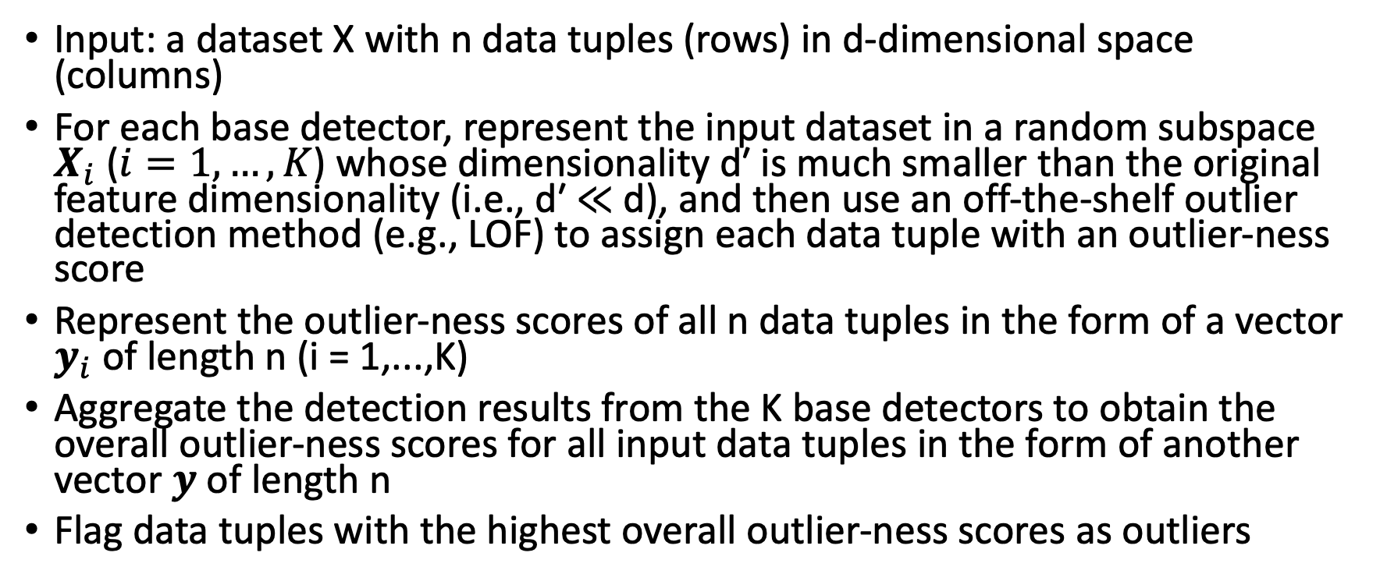
Outlier Detection Ensemble
Input: a dataset X with n data tuples (rows) in d-dimensional space (columns)
For each base detector, represent the input dataset in a random subspace $X_{i}$ ($i=1,…,K$) whose dimensionality d′ is much smaller than the original feature dimensionality (i.e., d′ ≪ d), and then use an off-the-shelf outlier detection method (e.g., LOF) to assign each data tuple with an outlier-ness score
Represent the outlier-ness scores of all n data tuples in the form of a vector $y_{i}$ of length n (i = 1,...,K)
Aggregate the detection results from the K base detectors to obtain the overall outlier-ness scores for all input data tuples in the form of another vector $y$ of length n
Flag data tuples with the highest overall outlier-ness scores as outliers

Slide 66
Outlier Detection Ensemble

Slide 67
Key Issues
How to represent the input data in a random subspace
Feature bagging: randomly select a few original features to form the representation of the input data in a random subspace
Rotated bagging: first generate a random subspace of dimensionality d′ (d′ ≪ d) and then project the input data into this subspace
How to aggregate the detection results of base detectors
Mean aggregation: the overall outlier-ness score of a given data tuple is the average of its outlier-ness scores from the K base detectors
Max aggregation: the overall outlier-ness score of a given data tuple is the maximum of its outlier-ness scores from the K base detectors
It is important to normalize (e.g., min-max normalization, z-score normalization) the outlier-ness scores of the base detectors before aggregation, so that the outlier-ness score of a base detector will not overwhelm the scores of other base detectors

Slide 68
Taming High-Dimensionality by Deep Learning
Deep learning methods (e.g., autoencoder, feed-forward neural networks, CNNs, RNNs, GNNs) produce vector representation (i.e., embedding) of the input data tuples with a much smaller number of dimensions than the original ones, and thus natural alleviate the high-dimensionality challenge
Owing to deep learning’s strong ability in learning semantically meaningful representation, the produced embedding often captures the complicate (e.g., non-linear) interaction between different input futures, and thus is capable of detecting outliers that might be overlooked by the alternative methods (e.g., linear matrix factorization based approaches)

Slide 69
Using Deep Learning as Pre-processing
Feed the input data set into an autoencoder, the output from the encoder produces the embedding of the input data tuples in a much lower dimensional space
With such embedding as the input, we can use outlier detection methods (e.g., proximity-based approaches, reconstruction-based approaches) to detect outlying tuples
Advantage: simple and flexible
Disadvantage: separating the embedding learning stage and outlier detection stage might lead to sub-optimal detection results

Slide 70
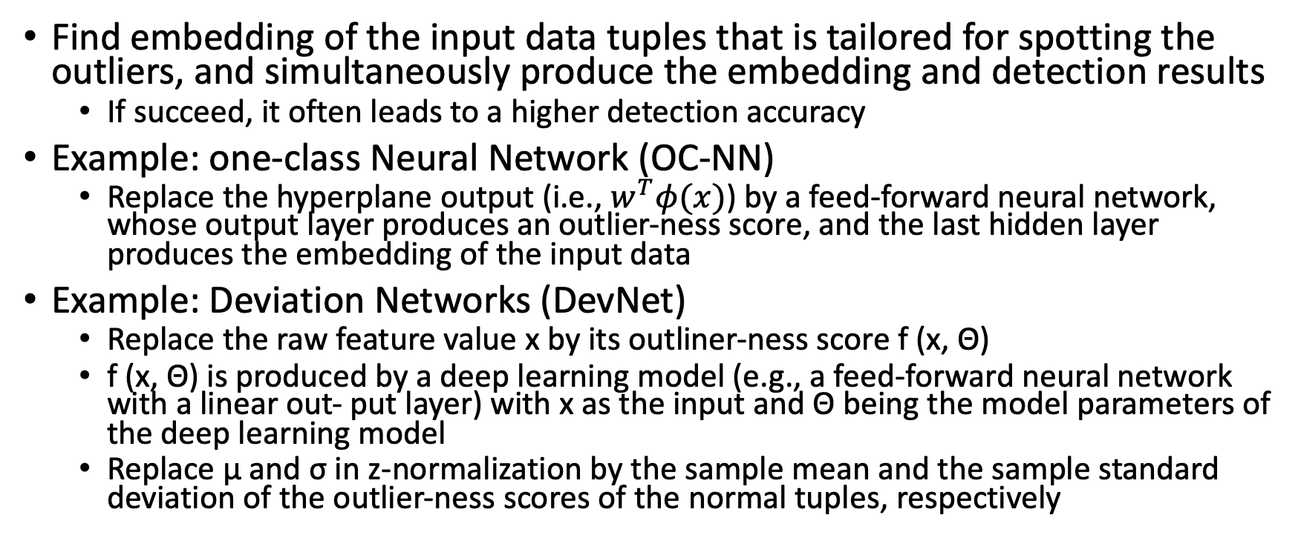
Integrating Embedding Learning and Outlier Detection
Find embedding of the input data tuples that is tailored for spotting the outliers, and simultaneously produce the embedding and detection results
If succeed, it often leads to a higher detection accuracy
Example: one-class Neural Network (OC-NN)
Replace the hyperplane output (i.e., $w^{T}φ(x)$) by a feed-forward neural network, whose output layer produces an outlier-ness score, and the last hidden layer produces the embedding of the input data
Example: Deviation Networks (DevNet)
Replace the raw feature value x by its outliner-ness score f (x, Θ)
f (x, Θ) is produced by a deep learning model (e.g., a feed-forward neural network with a linear out- put layer) with x as the input and Θ being the model parameters of the deep learning model
Replace μ and σ in z-normalization by the sample mean and the sample standard deviation of the outlier-ness scores of the normal tuples, respectively

Slide 71
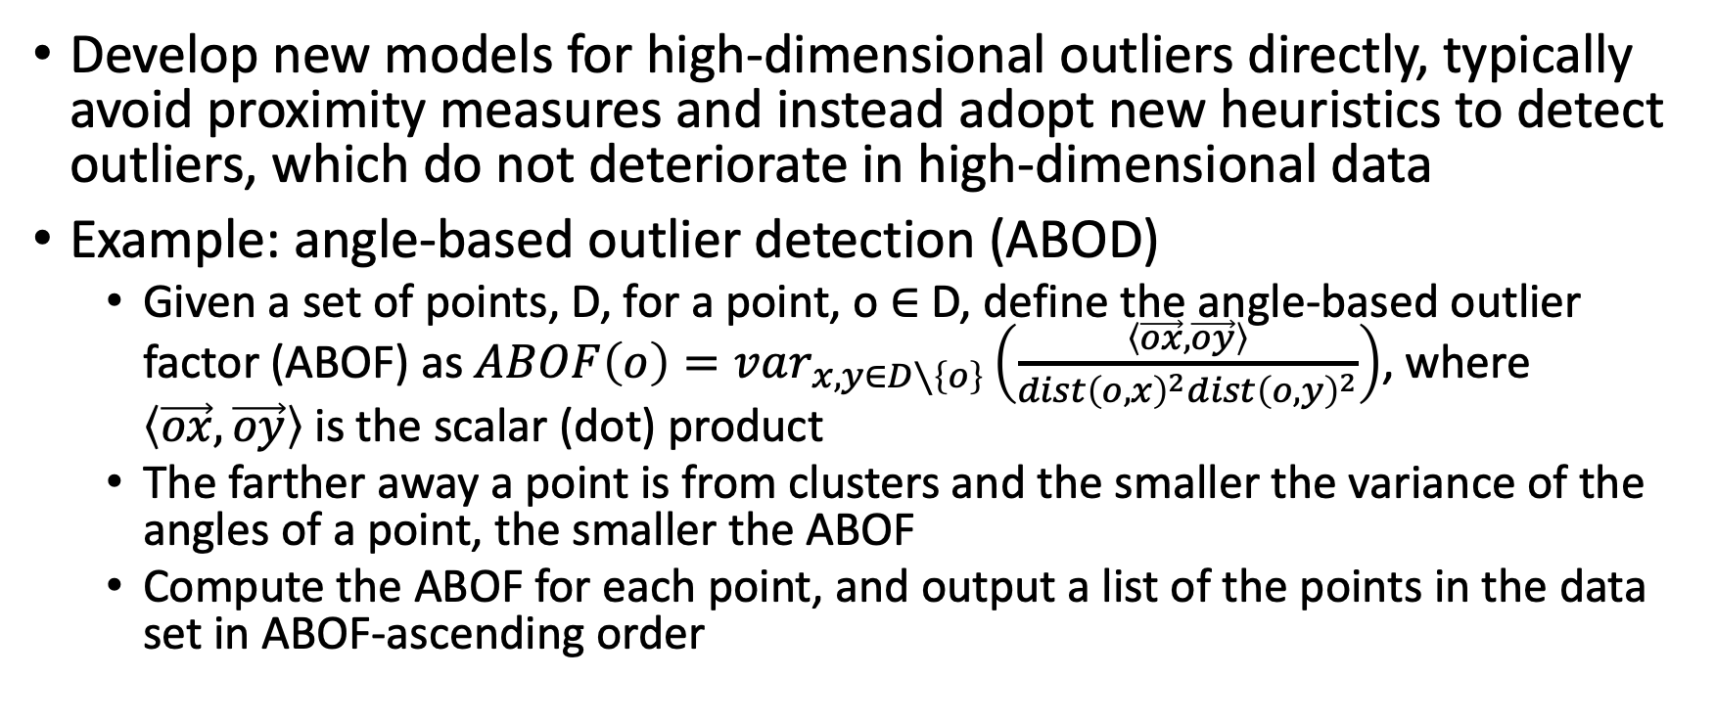
Modeling High-Dimensional Outliers
Develop new models for high-dimensional outliers directly, typically avoid proximity measures and instead adopt new heuristics to detect outliers, which do not deteriorate in high-dimensional data
Example: angle-based outlier detection (ABOD)
Given a set of points, D, for a point, o ∈ D, define the angle-based outlier factor (ABOF) as $ABOF\left(o\right)=var_{x,y∈D∖\left\{o\right\}}\left(\frac{\left\langle \vec{ox},\vec{oy}\right\rangle }{dist{\left(o, x\right)}^{2}dist{\left(o,y\right)}^{2}}\right)$, where $\left\langle \vec{ox},\vec{oy}\right\rangle$ is the scalar (dot) product
The farther away a point is from clusters and the smaller the variance of the angles of a point, the smaller the ABOF
Compute the ABOF for each point, and output a list of the points in the data set in ABOF-ascending order

Slide 72
ABOD Example

